Slide 1

Tour and Travel Management System
Project Members:
240350320059-Vaishnavi Phirke
240350320060-Vedant Bajirao
240350320061-Vivek Rajput
240350320062-Yogita Patil
240350320063-Yusaf Shahid
240350320064-Zeeshan

Slide 2
Introduction
Travel Planning Challenges:
Travelers often find it difficult to gather reliable information, book accommodations, and manage their itineraries.
Existing solutions are spread across multiple platforms, leading to a fragmented and complicated user experience.
Need for Integration:
Current platforms lack integration, making it hard for users to find all necessary services in one place.
Personalized travel packages are often difficult to find, reducing the overall satisfaction of the trip.

Slide 3
Problem Statement
"Travelers find it difficult to get all the information, book packages that suit their needs, and manage bookings because there's no single system that brings everything together."
Problem Statement
Planning Challenges
No Integrated Solutions
Lack of Personalization
Admin Complexity

Slide 4

Solution
A centralized platform that simplifies travel planning by offering detailed information on popular tourist destinations in India.
Users can explore destinations, select travel packages based on their interests, and manage bookings seamlessly.

Slide 5
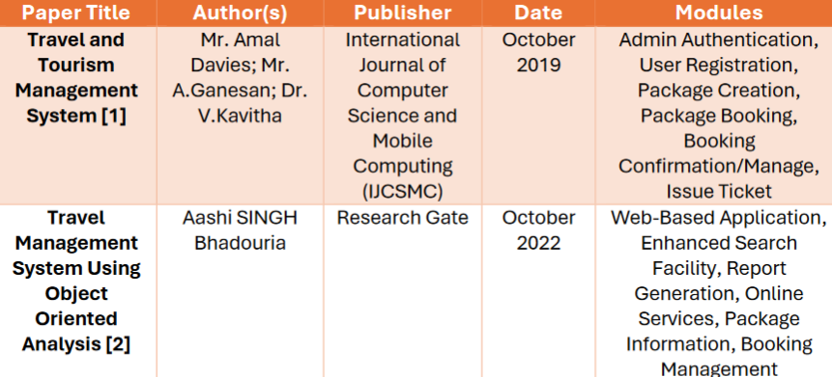
Literature Survey

Slide 6
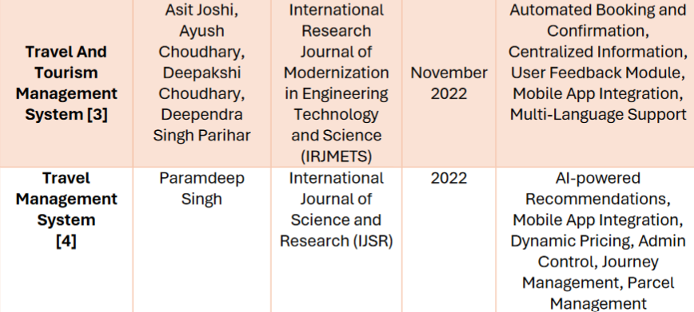
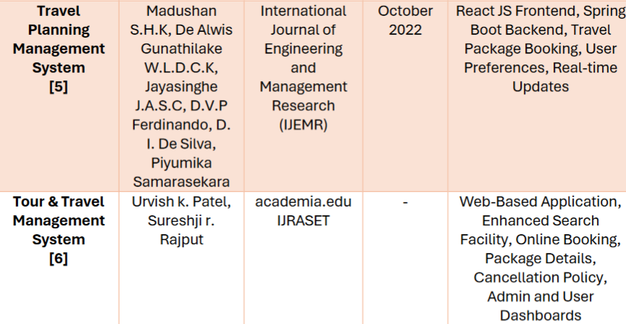

Slide 7
Objectives
Central Hub for Information
Booking Process
User Management
Guide Connection
Easy Package Selection

Slide 8
Proposed System
Home Page: Easy access to travel categories and destinations.
Admin Panel: Manage users, packages, and bookings.
User Profiles: Manage profiles and bookings.
Customer Interface: Explore and book packages.
Guide Section: Book local guides.
Sign In/Out: Secure authentication.
Categories & Orders: Browse and book categorized packages.

Slide 9
Technologies
Front-end: React.js
Back-end: Spring Boot
Database: MySQL
Developmet Tools: Eclipse IDE, Git

Slide 10

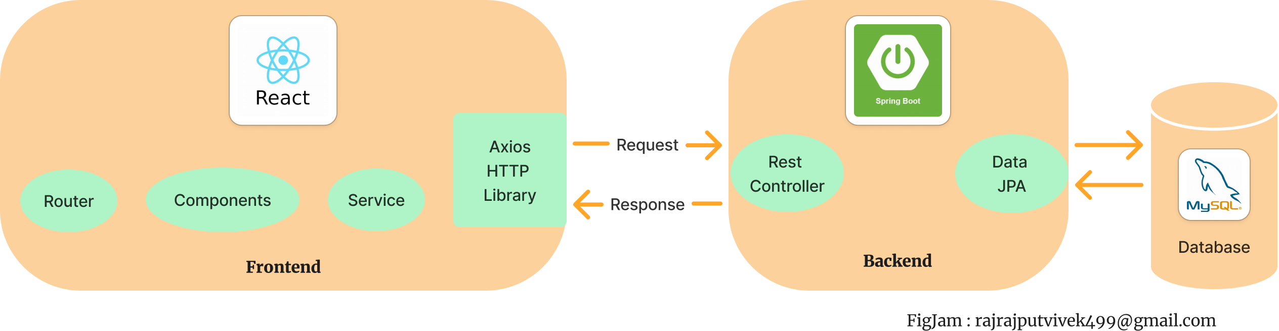
Block Diagram

Slide 11
Client Layer (User Interaction)
Browser Interface
User Inputs
Response Rendering

Slide 12
Application Layer (Processing and Logic)
Front-End (React.js):
Manages user interface
State
Page navigation.
Back-End (Spring Boot):
Handles business logic
Processes requests
Interacts with the database.

Slide 13
Database Layer (Data Storage and Retrieval)
MySQL Database
User Table
Booking Table
Guide Table
Categories Table

Slide 14
Admin Layer (Management Interface)
Admin Dashboard
User Management
Package Management
Booking Management
Guide Management

Slide 15
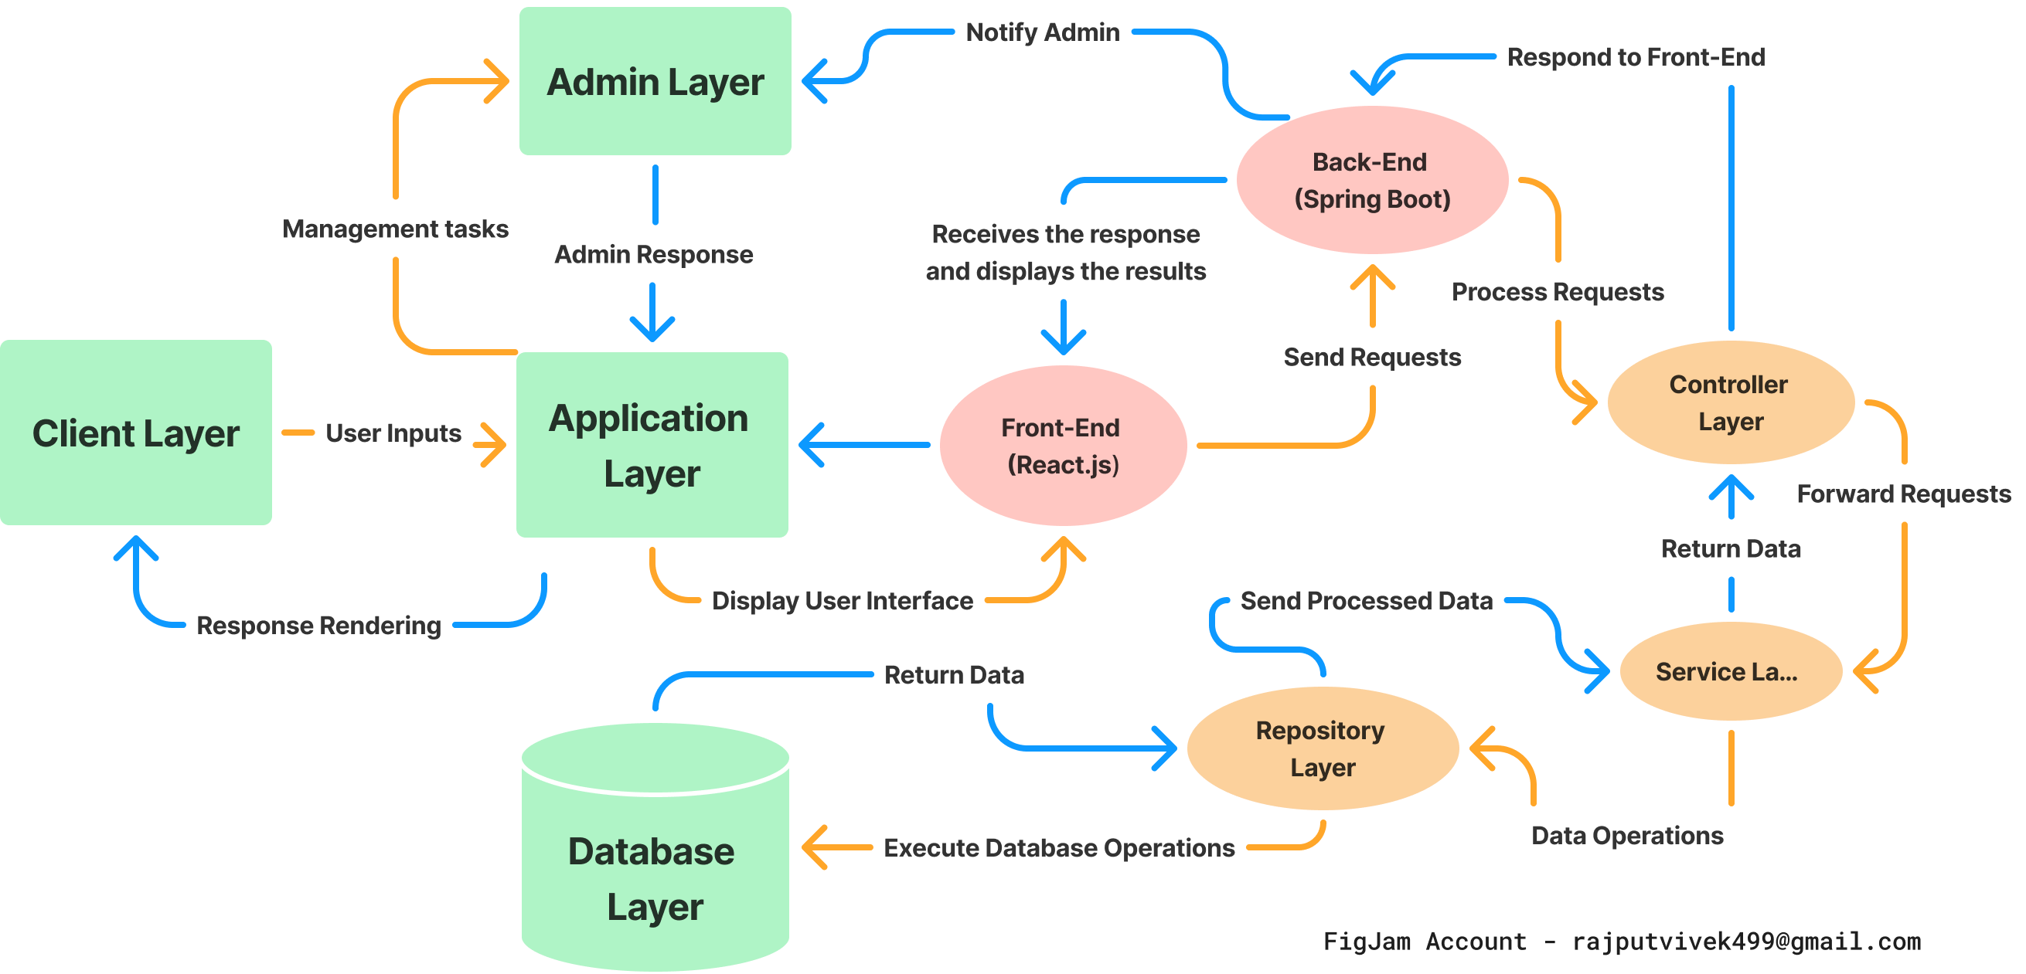
Flow Diagram

Slide 16
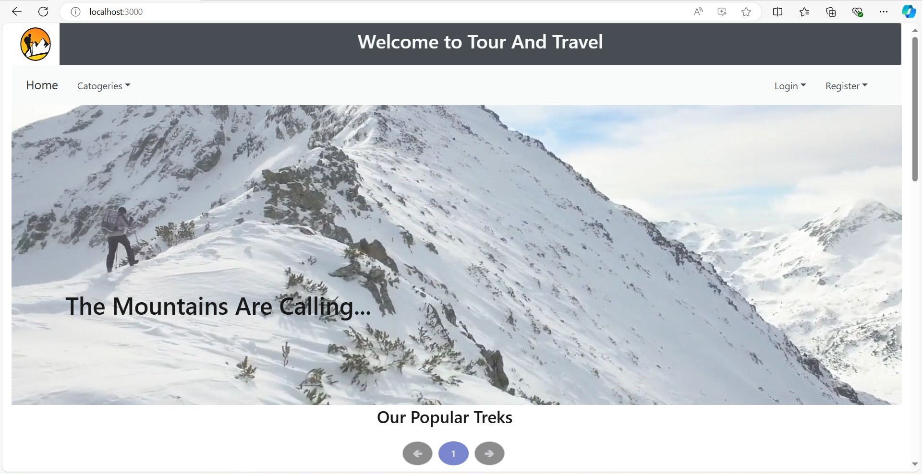
Home Page

Slide 17
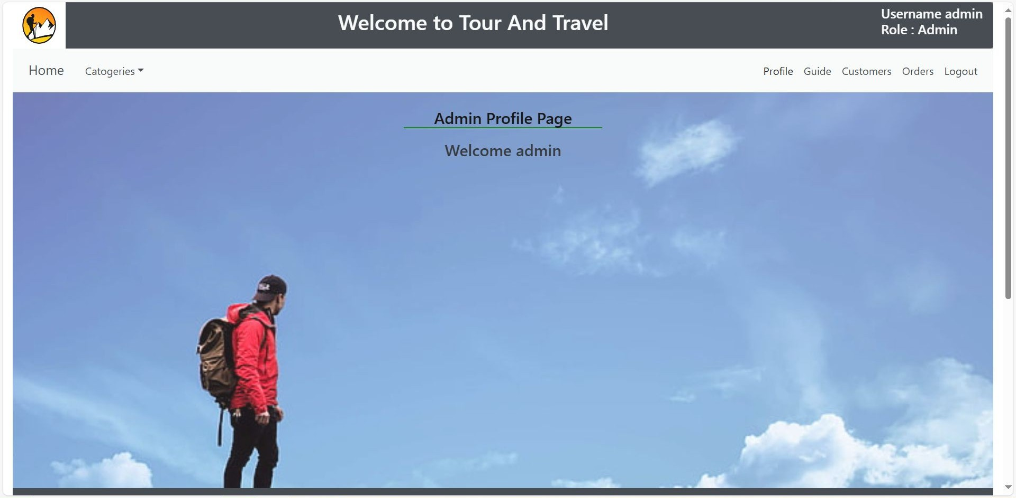
Admin Page

Slide 18
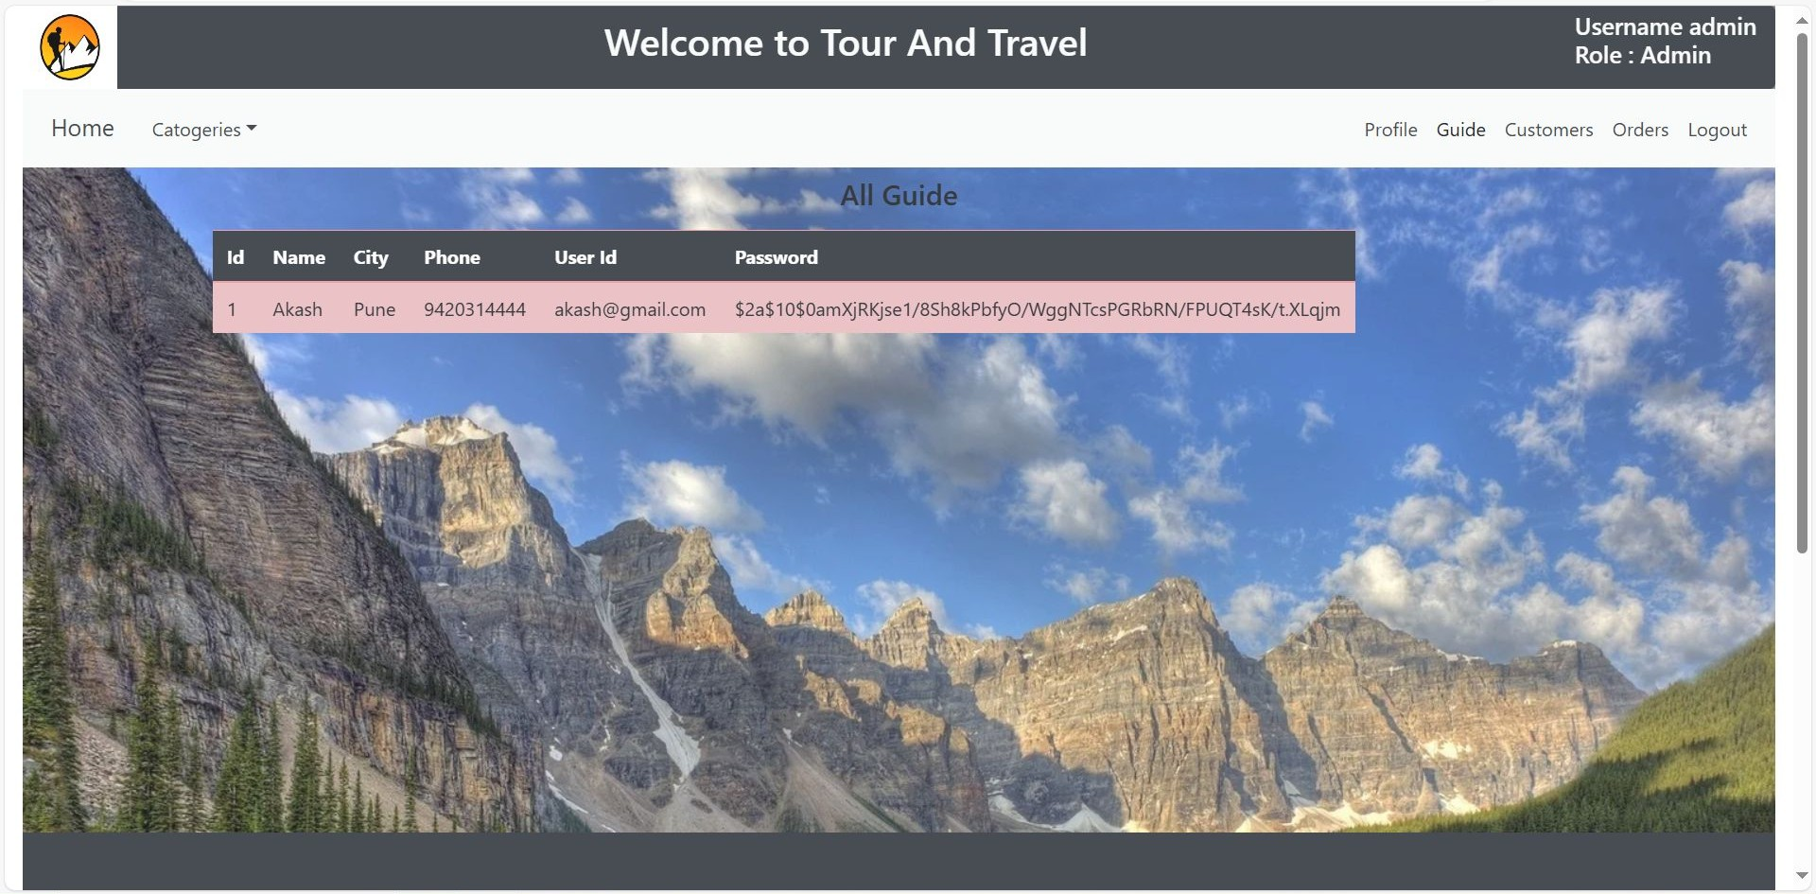

Slide 19
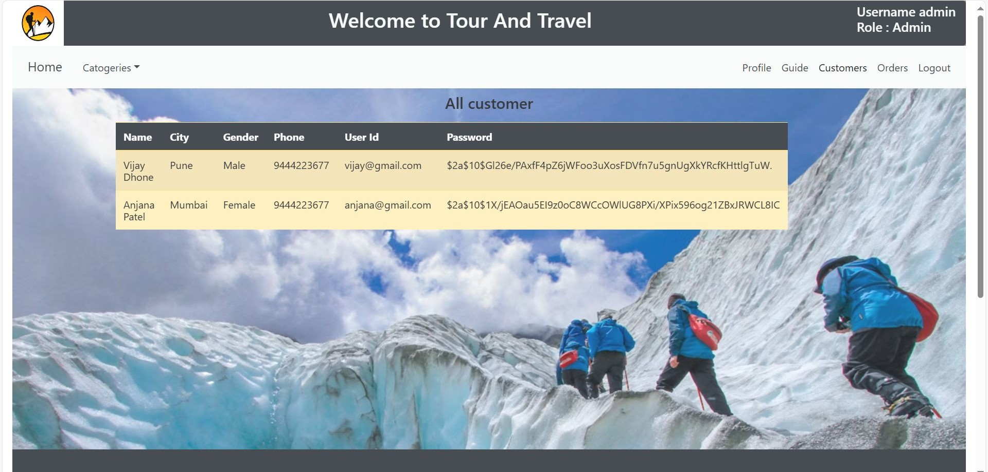

Slide 20
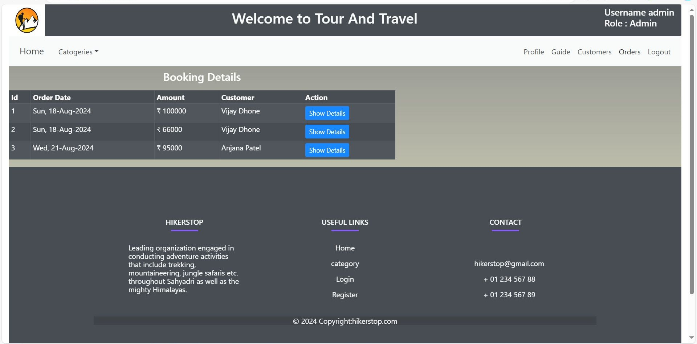
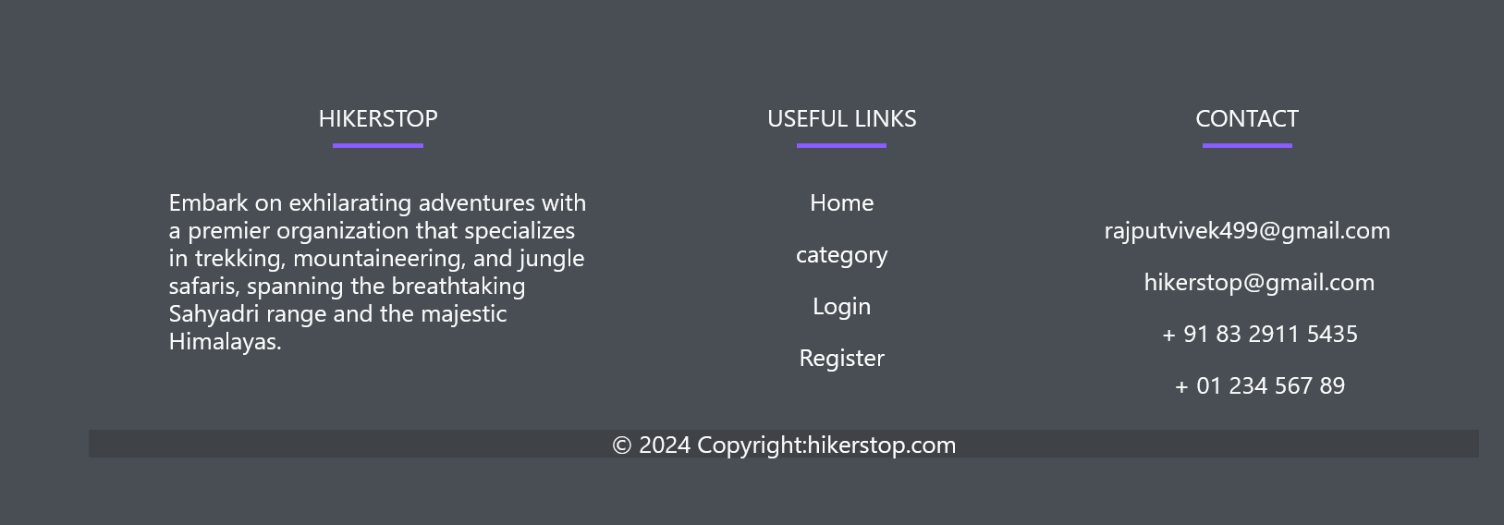

Slide 21
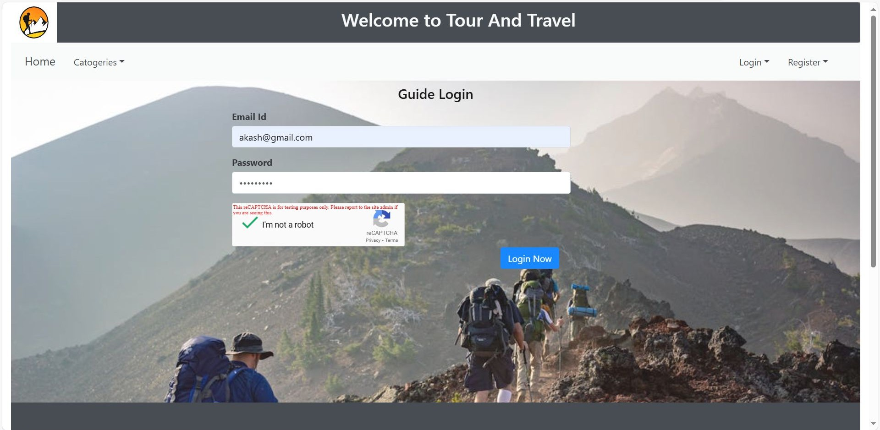
Guide Login

Slide 22
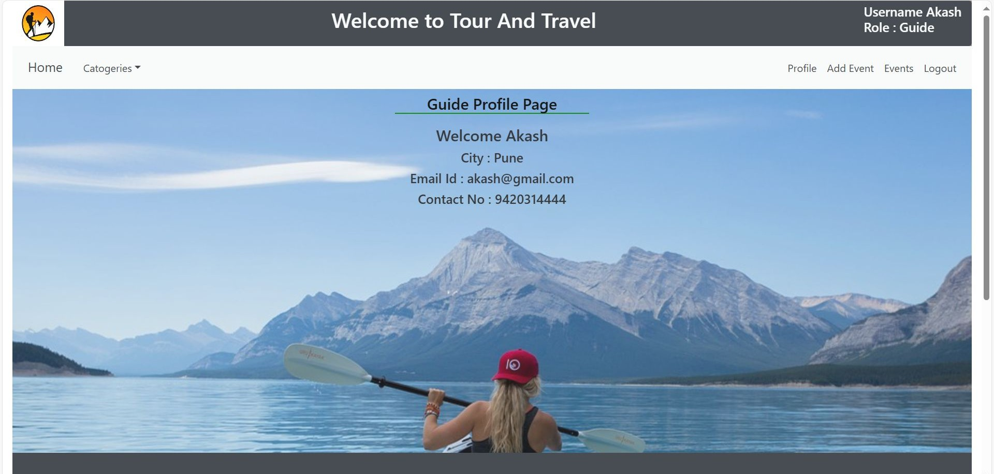

Slide 23
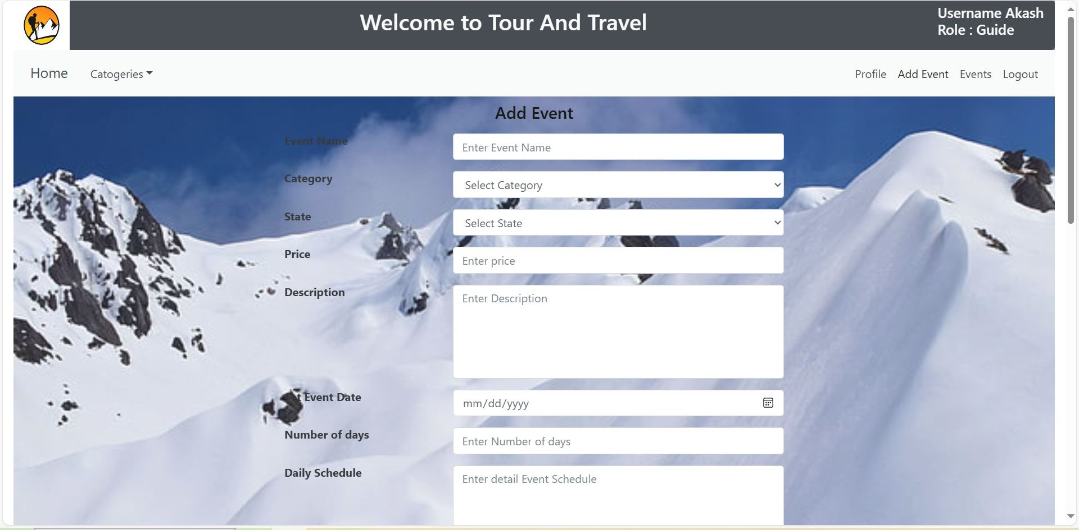

Slide 24
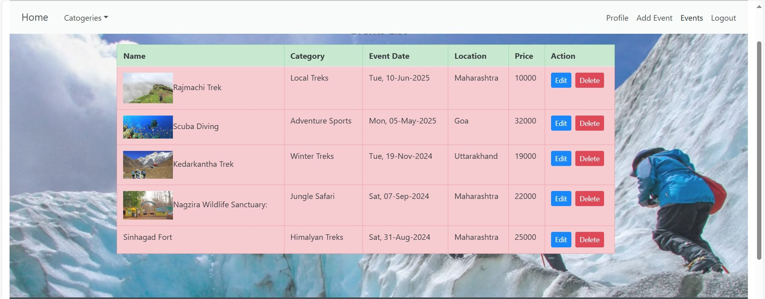

Slide 25
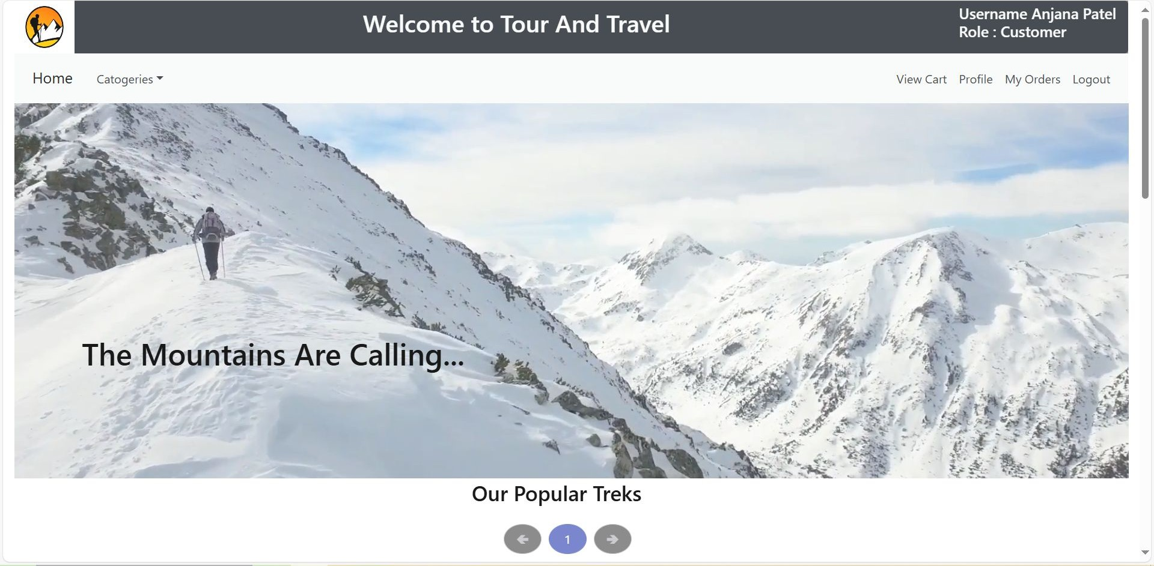
User Login

Slide 26
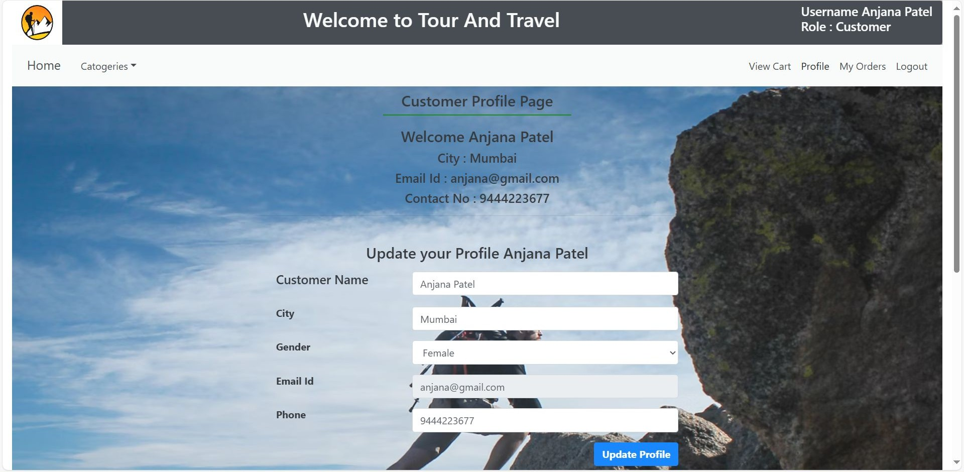

Slide 27
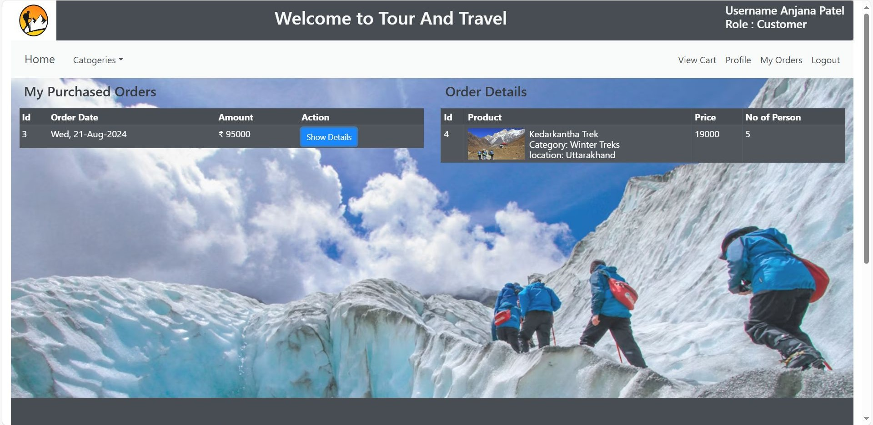

Slide 28
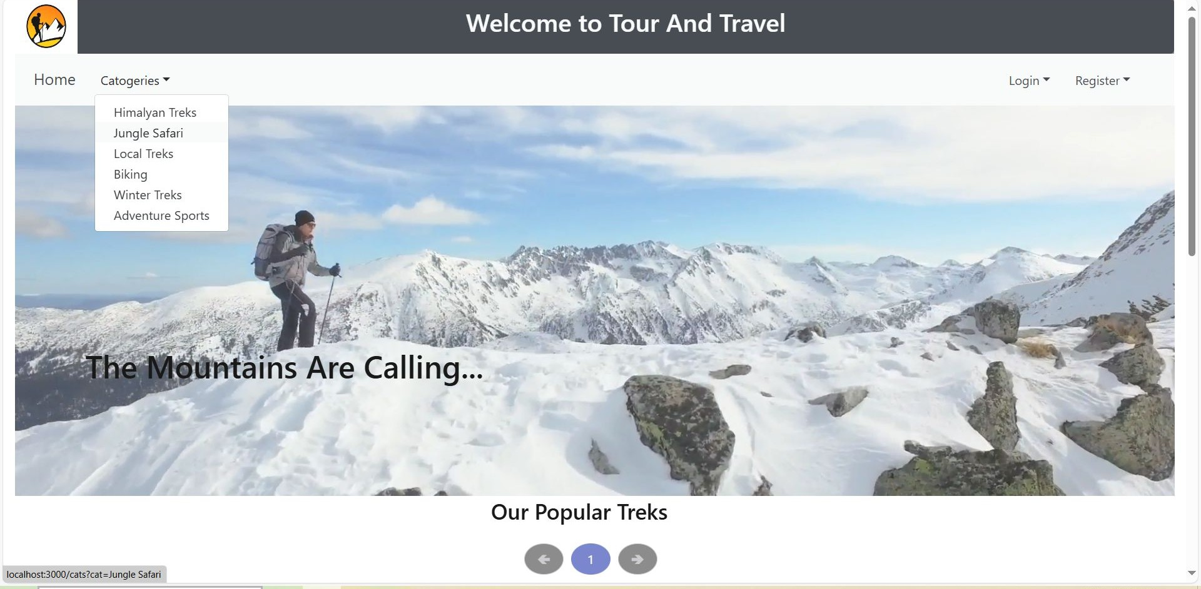
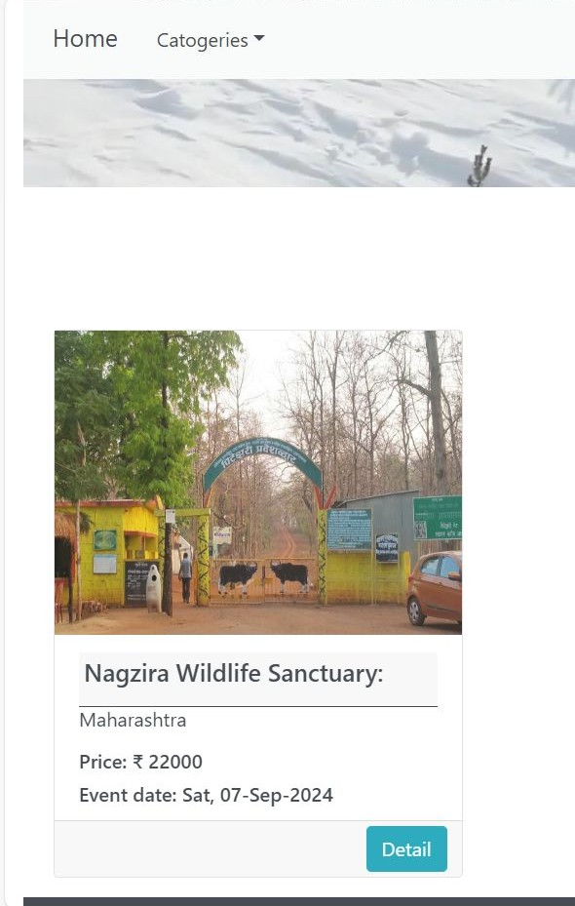

Slide 29
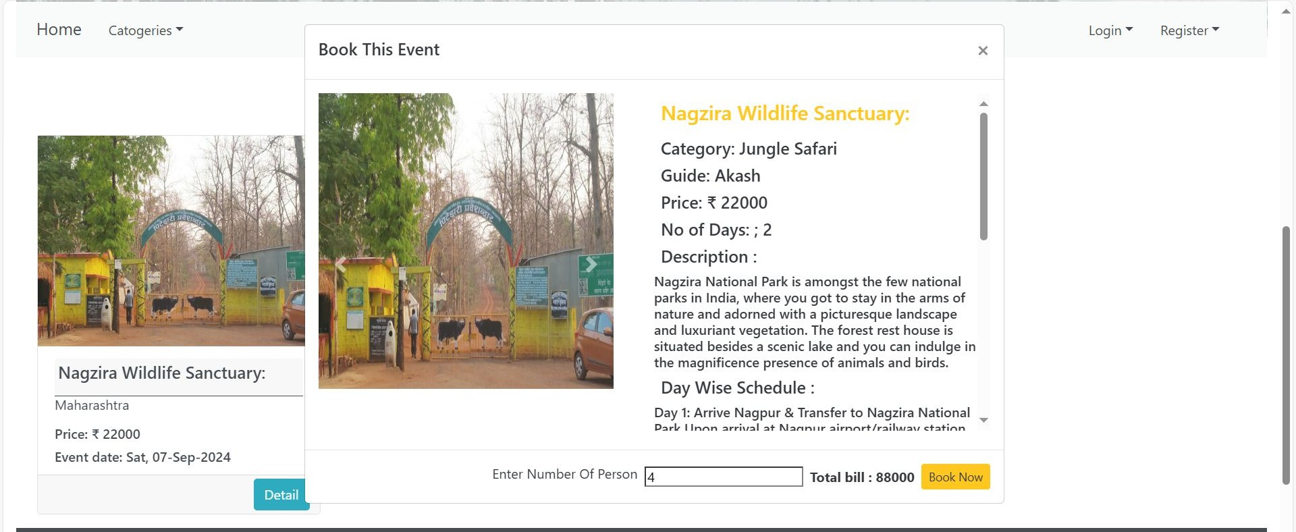
Tour Booking

Slide 30
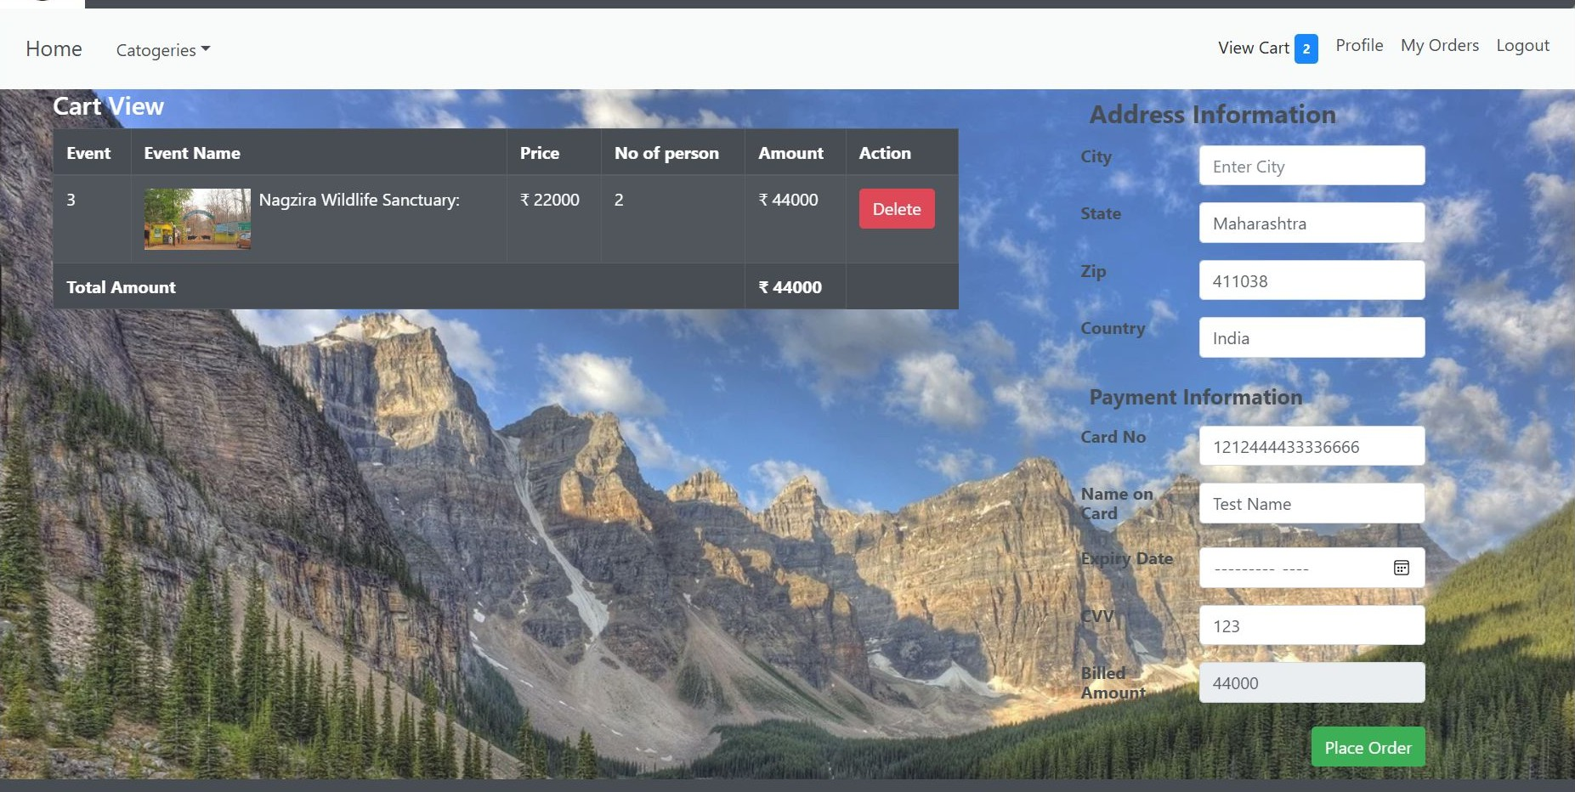

Slide 31
Project Planning
Phase | Weeks | Tasks | Deliverables
Planning | Week 1-2 | - Gather requirements | - Requirement specifications
 |  | - Select technologies | - Design outline
 |  | - Initial design
Design | Week 3-4 | - Detailed system design | - System design documents
 |  | - Architecture planning | - UI/UX mockups
 |  | - UI/UX design
Development | Week 5-6 | - Front-end development using React.js | - Completed modules
 |  | - Back-end development using Spring Boot | - Integrated system
 |  | - Database setup and integration with MySQL
Testing | Week 7-8 | - Unit testing | - Test reports
 |  | - Integration testing | - Bug fixes
 |  | - User acceptance testing

Slide 32
Resource Allocation | Developers, designers, testers | Proper resource distribution and management
Tools | React.js, Spring Boot, MySQL, Eclipse IDE | Effective use of tools for project completion
Risk Management | Technical Risks: Integration issues, performance concerns | Regular testing, proven technologies
 | Operational Risks: Resource constraints | Contingency planning, detailed scheduling
Timeline and Deliverables | Visual Schedule | Key deliverables: Design documents, system modules, test reports

Slide 33
Future Scope
AI-based recommendations.
Multi-language support.
Mobile app development.
Social media integration.

Slide 34
Limitations
Scalability issues.
Internet dependency.
Security challenges.

Slide 35
References
https://ijcsmc.com/docs/papers/October2019/V8I10201903.pdf
https://www.researchgate.net/publication/364930117_TRAVEL_MANAGEMENTT_SYSTEM_USING_OBJECT_ORIENTED_ANALYSIS
https://www.irjmets.com/uploadedfiles/paper/issue_11_november_2022/31296/final/fin_irjmets1668667736.pdf
https://www.ijsr.net/archive/v12i5/SR23512140937.pdf
https://papers.ssrn.com/sol3/papers.cfm?abstract_id=4270998
https://www.academia.edu/36249877/TOUR_and_TRAVEL_MANAGEMENT_SYSTEM

Slide 36
Thank you

